Slide 1


Project Topic “Quiz App”
Bharati Vidyapeeth
(Deemed To Be University),Pune (India)
Institute of Management and Entrepreneurship Development, Pune
Established u/s 3 of UGC Act, 1956 video Notification no.F-9-15/95 U.3 of the Government of India.
Under the
Guidance
of
Dr. Ajit More Sir
Mahesh Patil(60)
Rahul Kumar(63)

Slide 2
1.1 About the project
The project “Quiz APP” is an Android -based project implemented in Android studio with core java and XML for Designing.
This is designed to provide better facility to solve any type of question with various categories mentioned.
Quiz App is for improve your knowledge with various categories (like Computer Science, Environmental, Sports,etc with various sets of questions.
Also, admin has responsibilities to add, update, delete questions, question sets as well as question categories.
User can experienced with various kinds of questions for related to any kind of field.

Slide 3
1.2 Objectives
Quiz App will provide easily access to all the categories with kind of questions.
This app is totally based on administrative control. Thus, only admin can access the data . Also he has rights to manage the overall data.
The main objective is easily select any kind of question category with specific set number and start your quiz.4
Every person wants verity of questions with all the fields .So, this function works for this app.
The another main object8ve for this Quiz App is to facilitate a user-friendly environment for all the users.
Also, each user can check the results at last when quiz submit.

Slide 4
Existing System
The present System is tedious and provides less flexibility and is Time Consuming.
Similarly all the different types of data or the records such as, quiz category, set of questions etc. are required to be stored and maintain manually and it takes a lot of time.
Also, the existing system does not provide the more flexibility and maintainability in terms of stored and retrieval of data easily. Also it has some difficulties like less flexible in stored the quiz categories, questions set numbers etc.

Slide 5
Proposed System
With this project report, we are presenting our android app. Also our proposed system has many kind of user interfaces for data operations and also these are interactive as per the users and operator’s approach.
It performs various data operations such as:
Insert , Update and Delete the data of Quiz Categories.
Insert , Update and Delete the data of Question sets admin.
Also, Insert, Update, Delete the Questions by admin.
Inset, Update , Delete the Questions marks by admin.
By using this proposed system, the whole system is android based. Whenever users want any information about new quiz categories , new questions sets added , anything updates about the quiz are available here from the database.

Slide 6
System Requirement
OS-Windows
RAM - 2 GB
Hard Disk – 500 GB
Graphics Card – 512 MB

Slide 7


Requirement Analysis
Software:
Firebase database:
Storage Analysis
1. User APP:
4.7 MB (Apk)
2. Admin App:
5.1 MB (Apk)

Slide 8
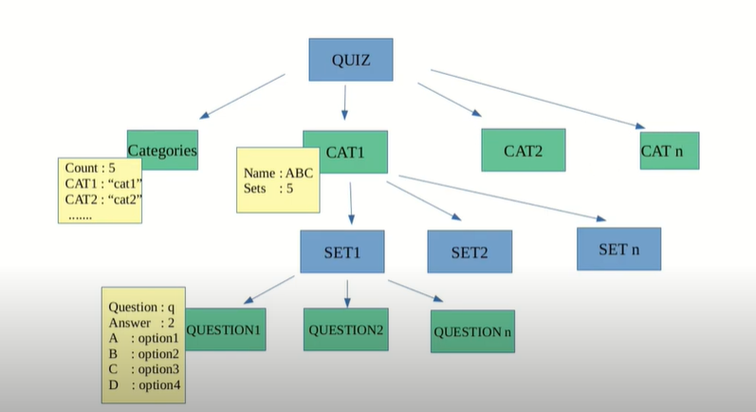
Data base Structure
1.4 Conceptual Map

Slide 9
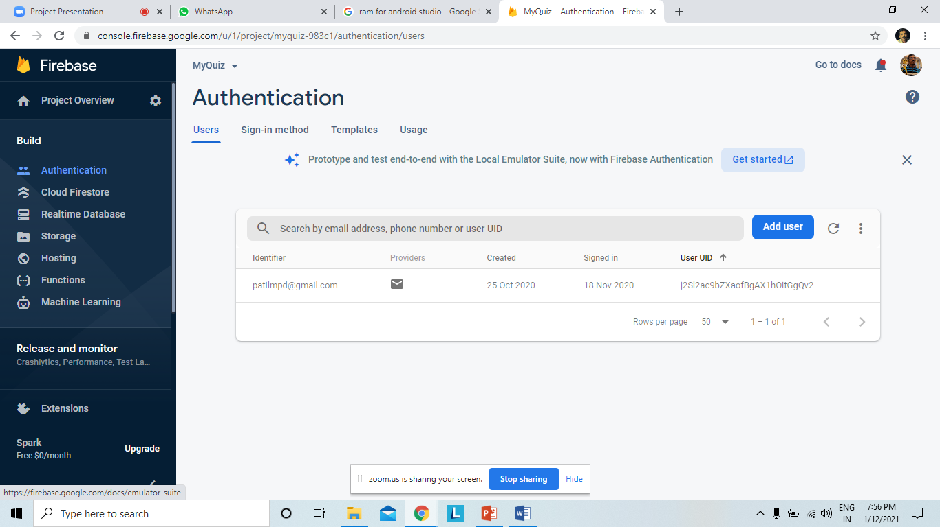
Admin Authentication

Slide 10
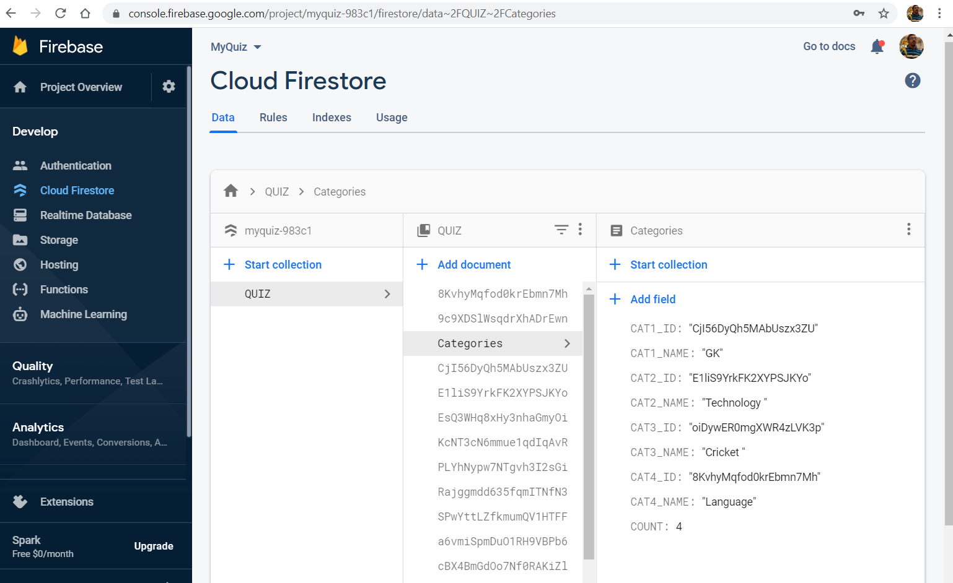
Database structure

Slide 11
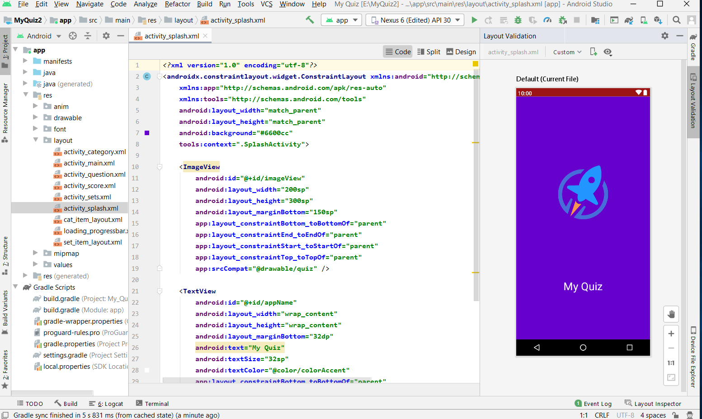
1.5 UI Designs
User-side screens

Slide 12
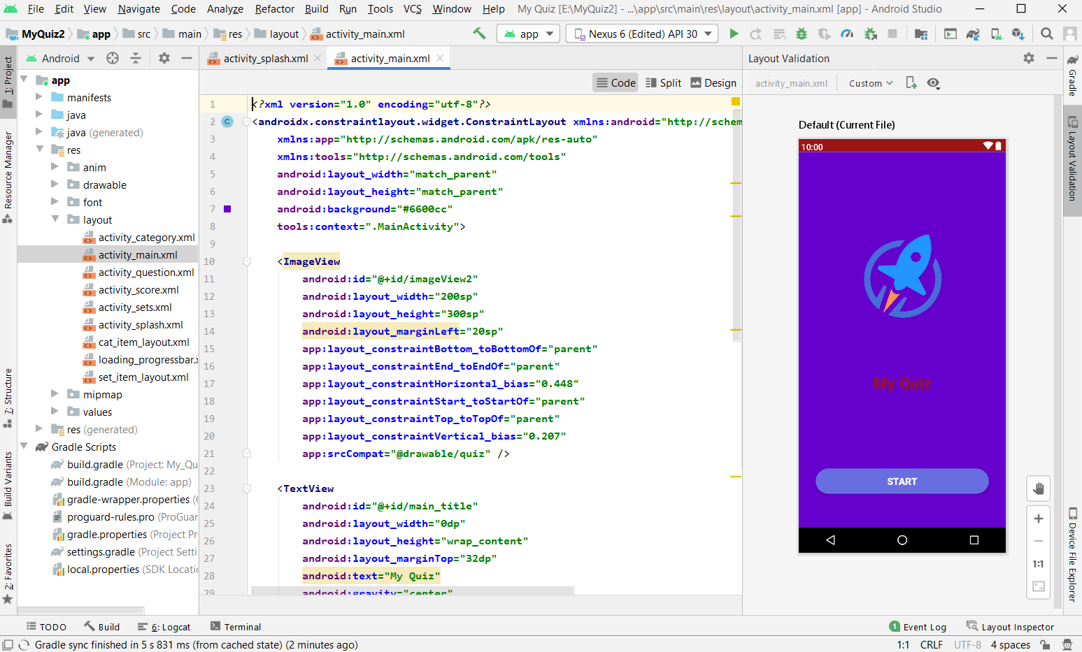
Main screen

Slide 13
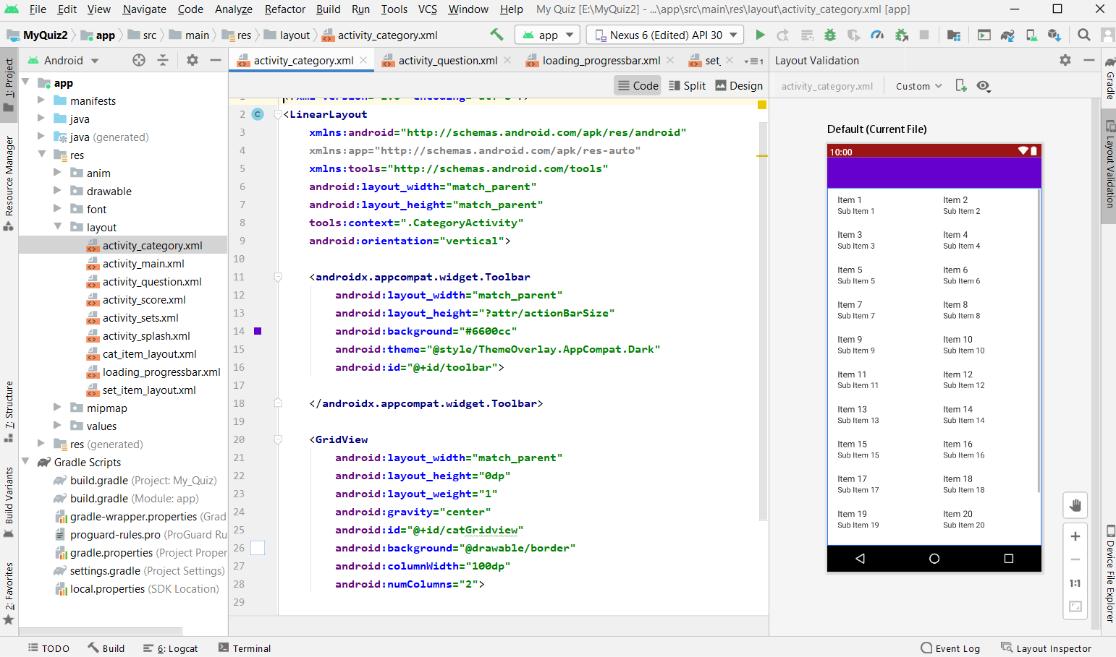
Categories screen

Slide 14
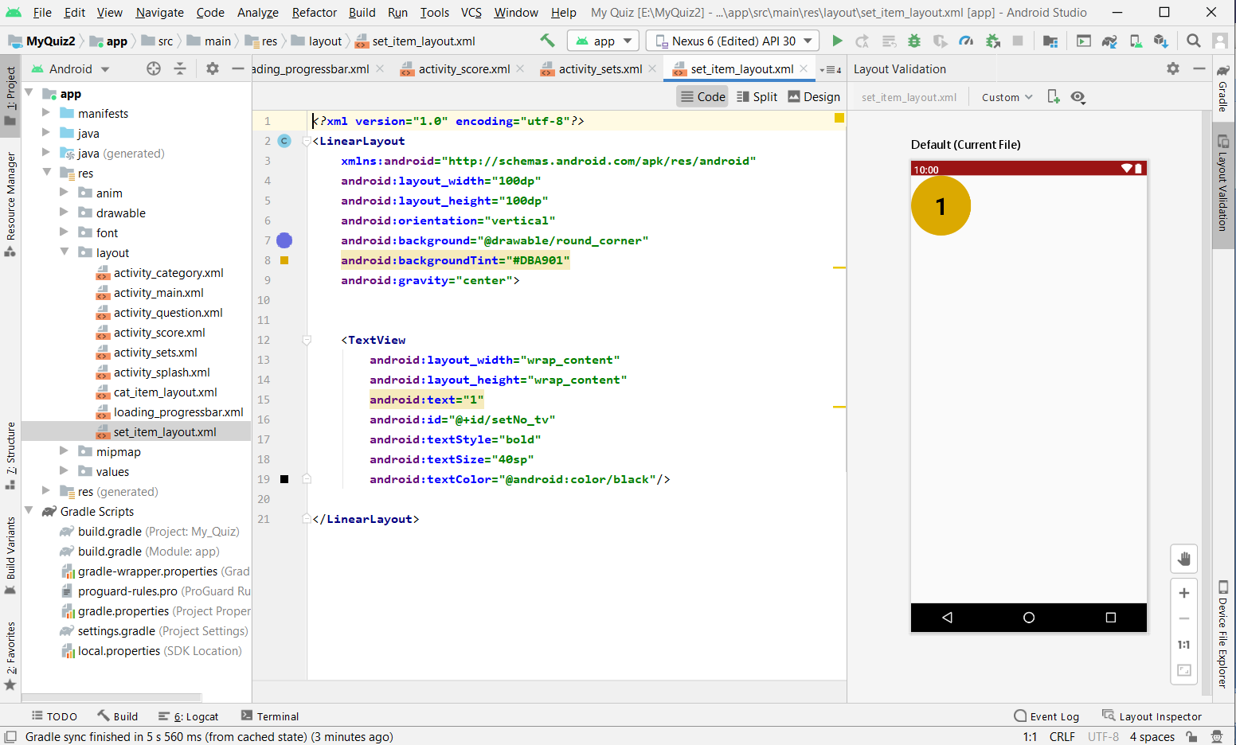
Set screen

Slide 15
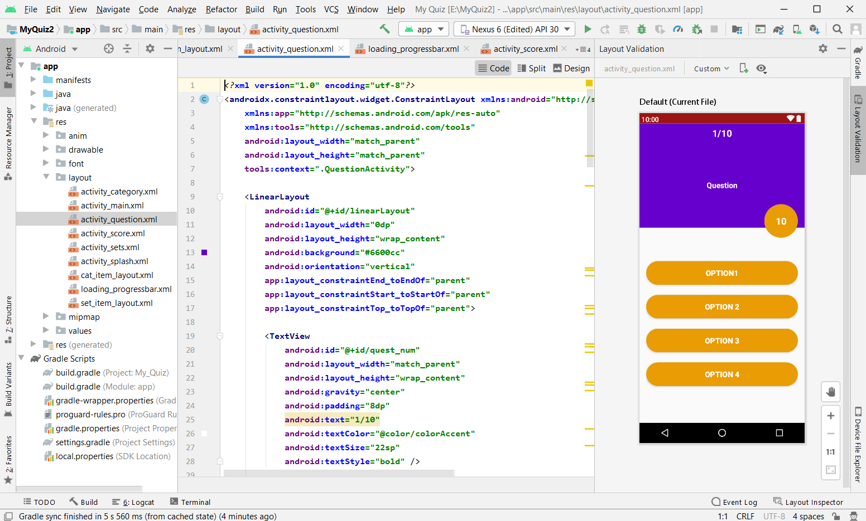
Questions screen

Slide 16
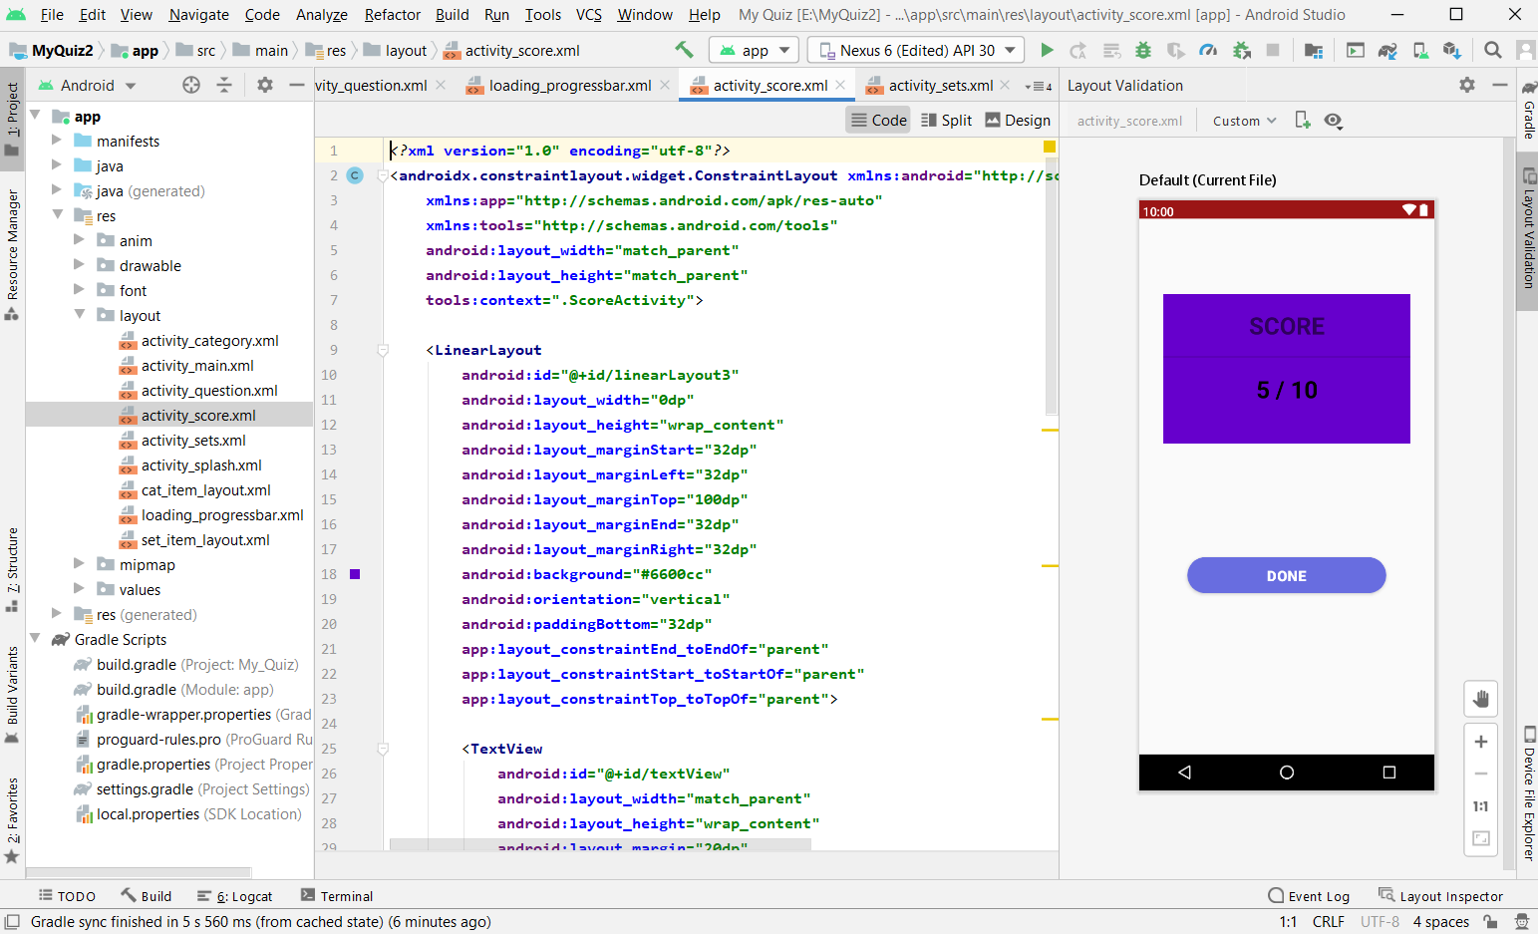
Score screen

Slide 17
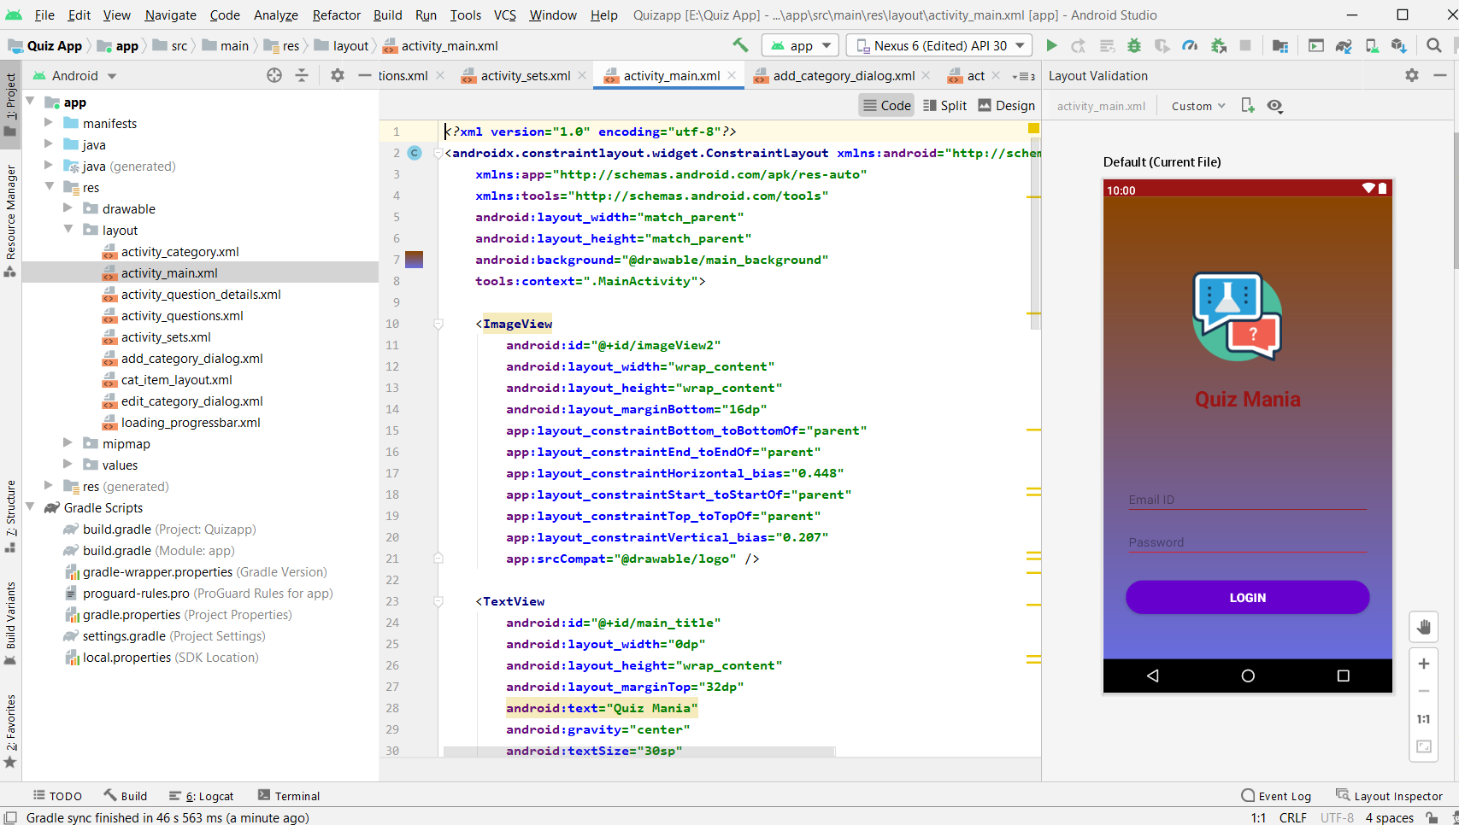
1.5.1 UI Designs- Admin Part
Login screen

Slide 18
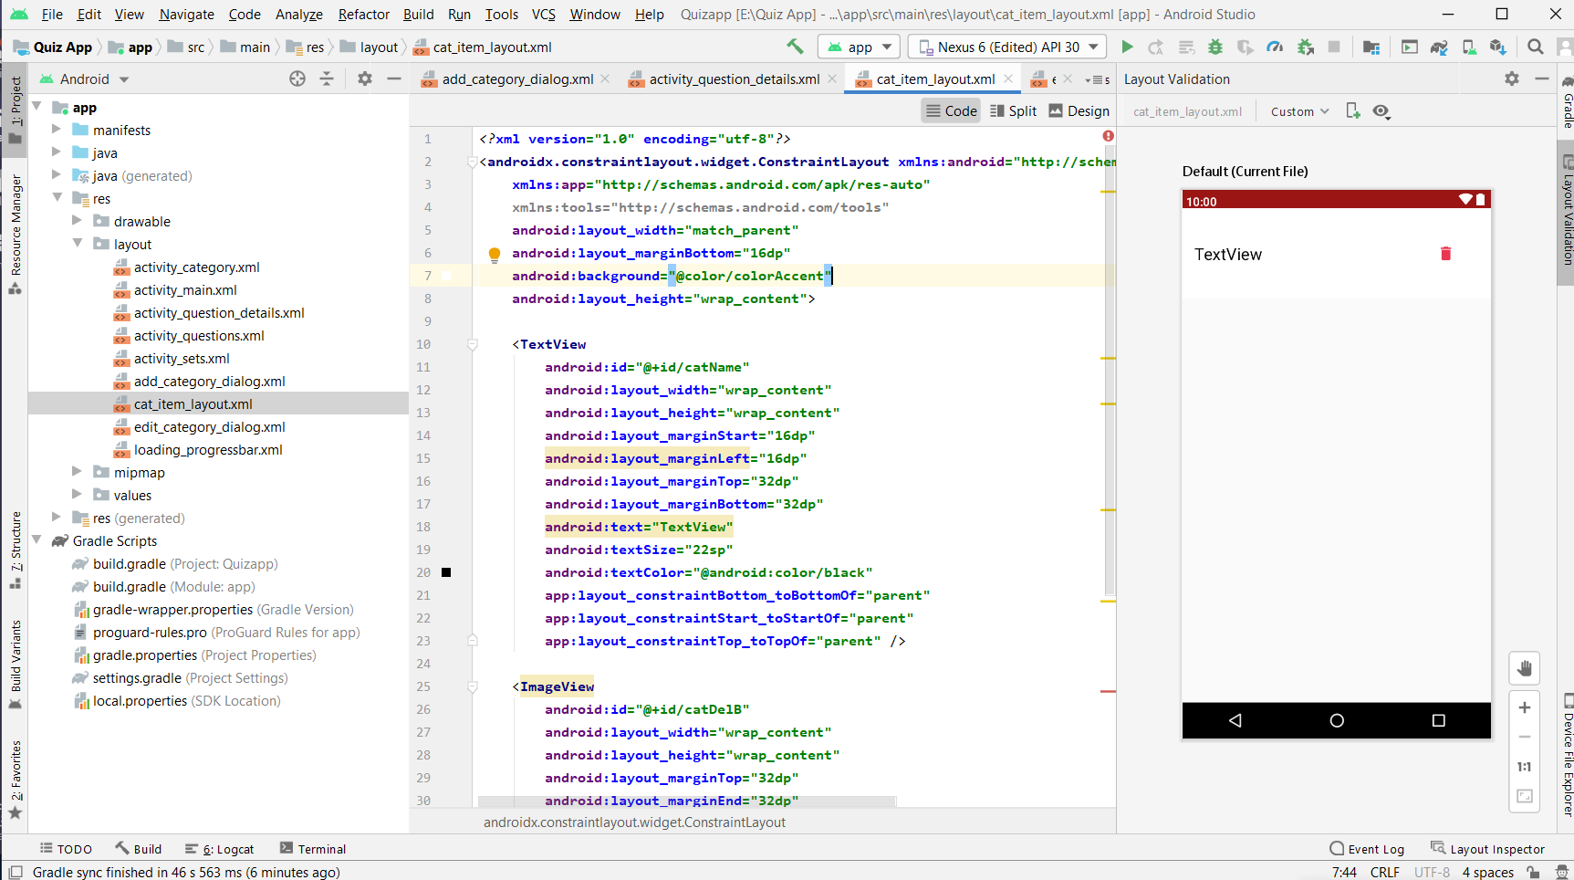
Categories Screen

Slide 19
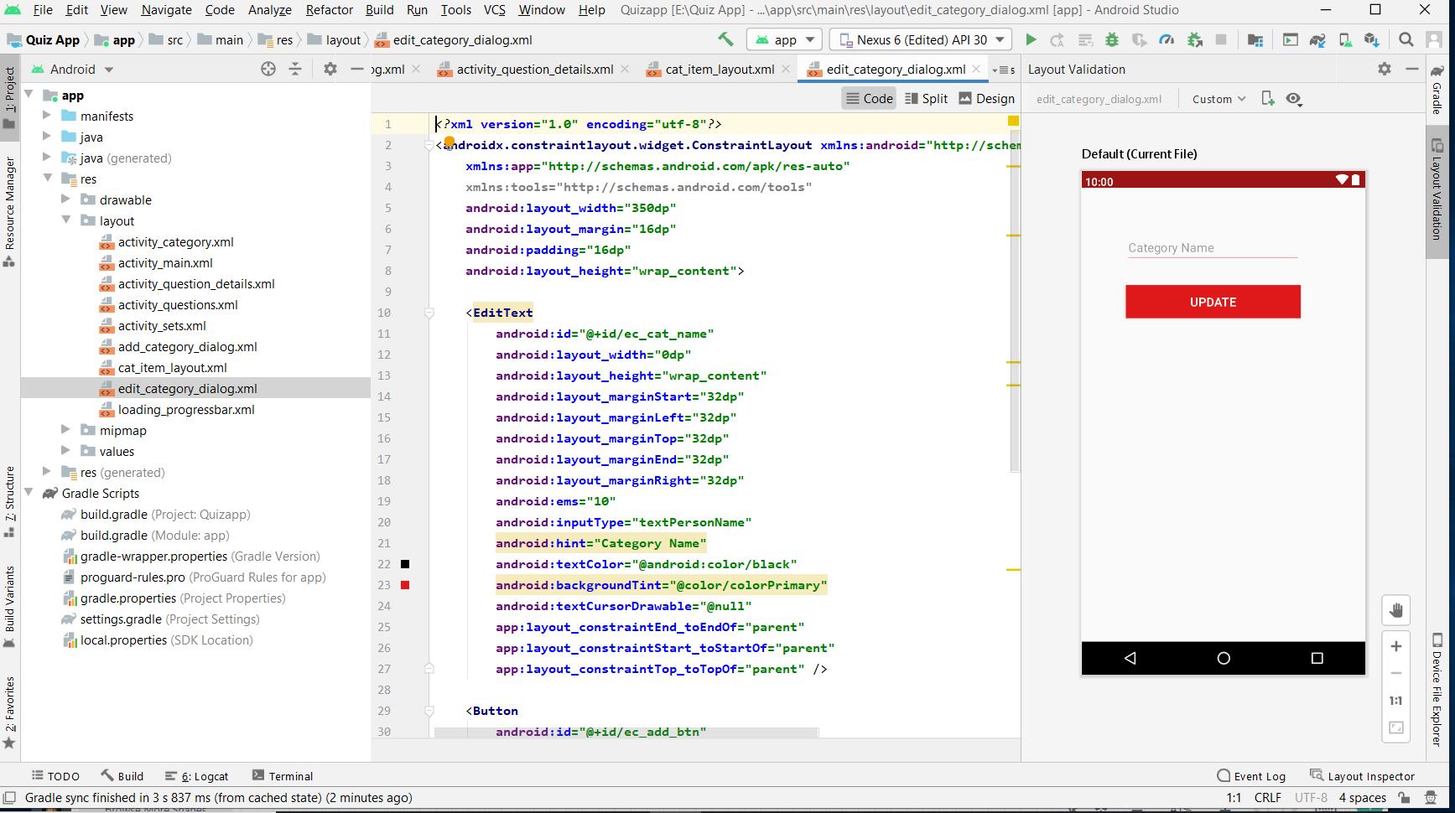
Edit -Category Screen

Slide 20
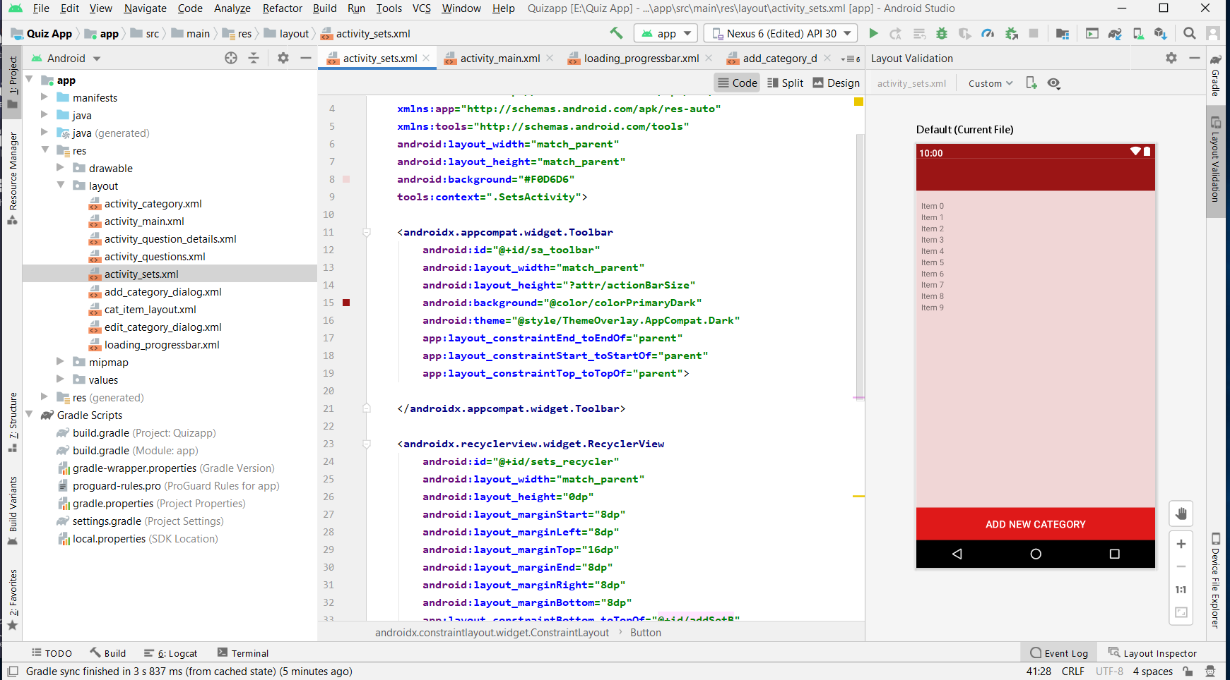
Sets Screen

Slide 21
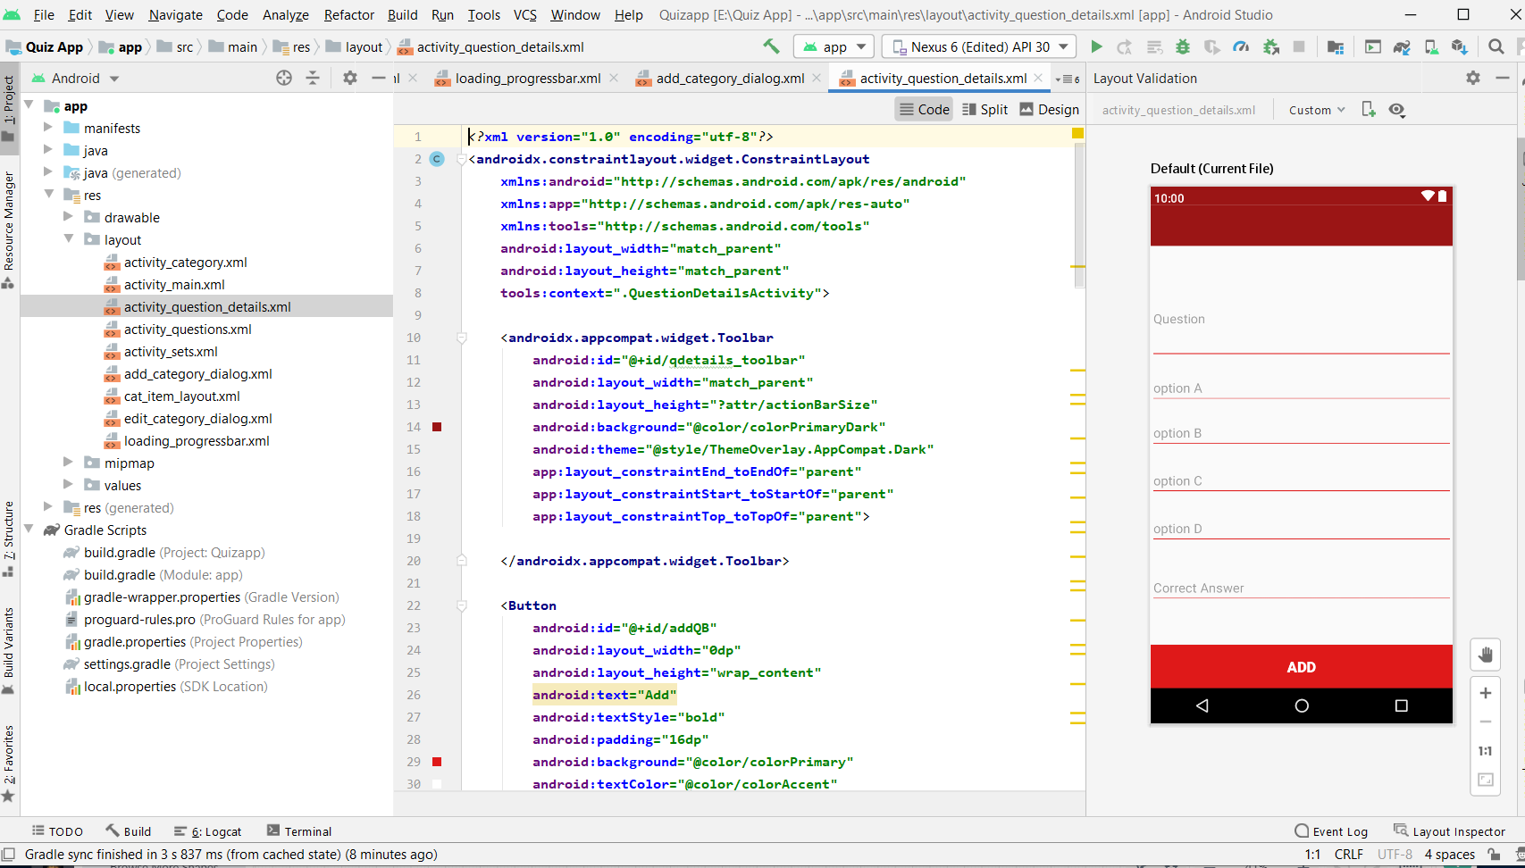
Questions Screen

Slide 22
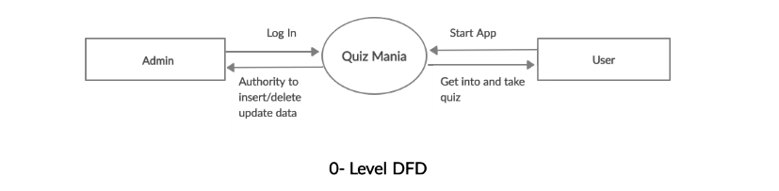
UML Diagrams
Data -Flow Diagrams

Slide 23
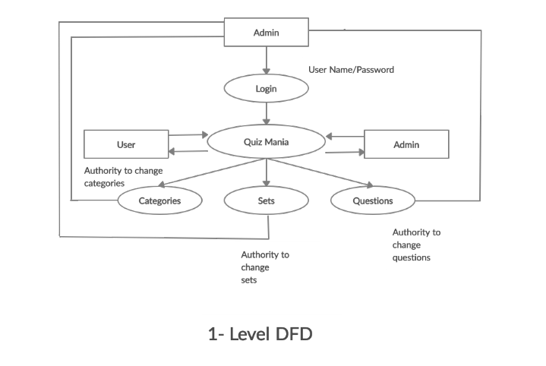

Slide 24
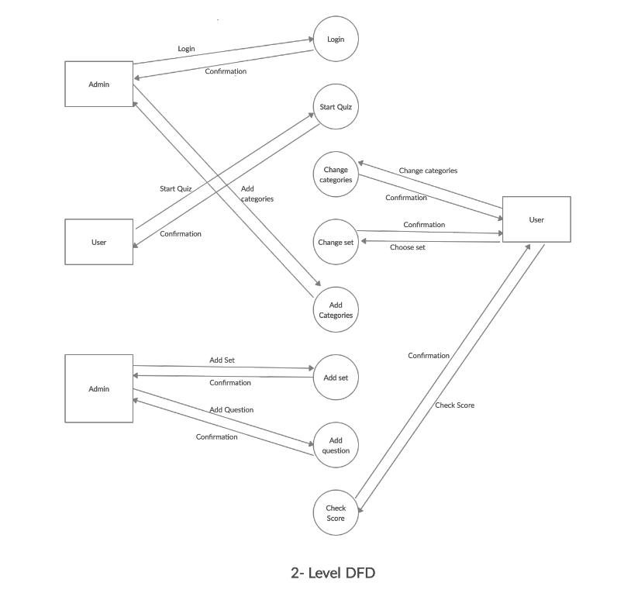

Slide 25
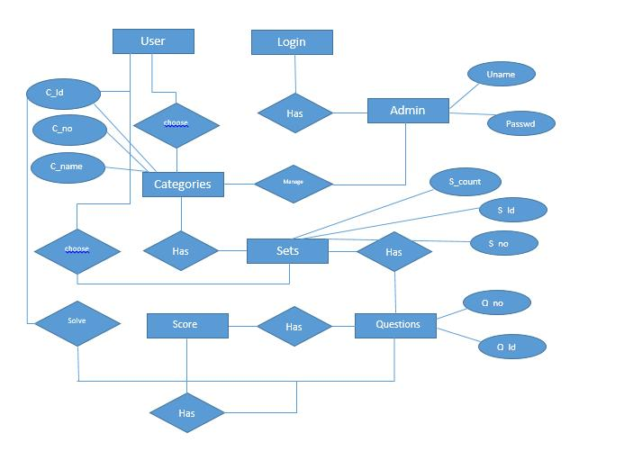
ERD - Diagram
QUIZ
Has

Slide 26
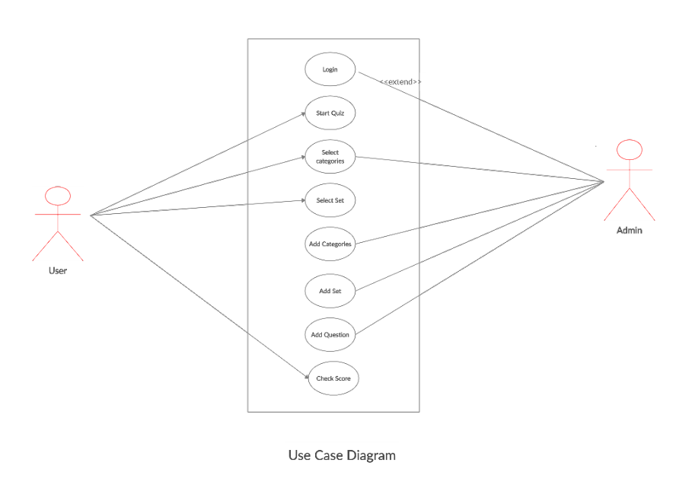
Use-Case Diagram

Slide 27
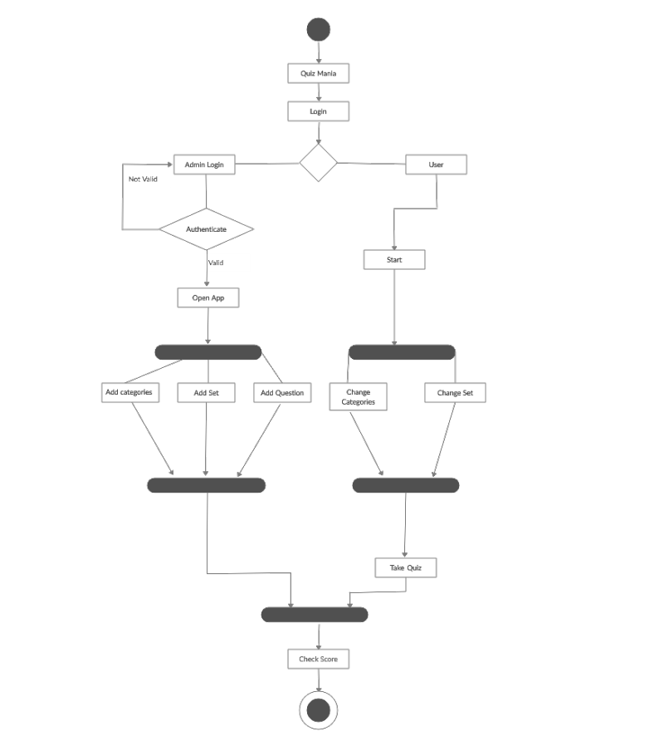
Activity Diagram

Slide 28
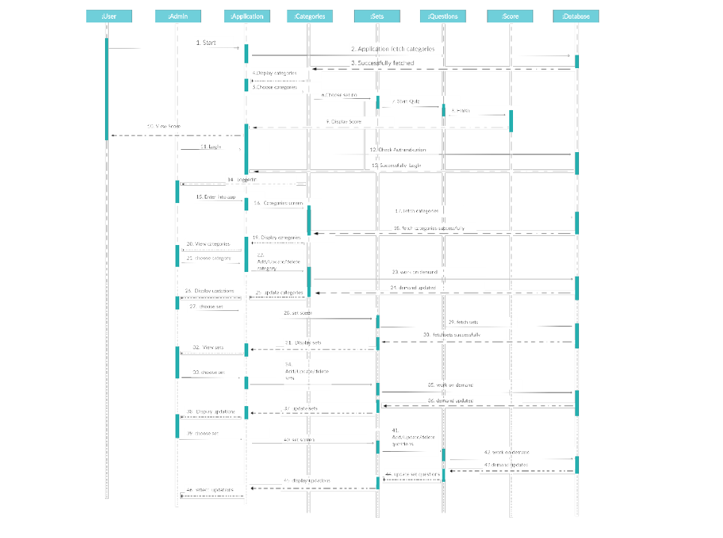
Sequence Diagram

Slide 29
Future Scope
For this Quiz App, there will be great future modification chances.
Modifications like-
User leader board
No. of Test given
Developer can add facility of No. of questions submitted, No. Of questions remaining, Right questions, Wrong questions, etc.
Also, developer can add reward winning concept for the the users.

Slide 30
Thank You !!!!

